Slide 1
RENT A CAR SYSTEM
BY AHMED RASHID
Core Features:
Admin Login
Add, Remove, Edit, Rent, and Return Cars ETC
Categorization: Economy & Luxury

Slide 2
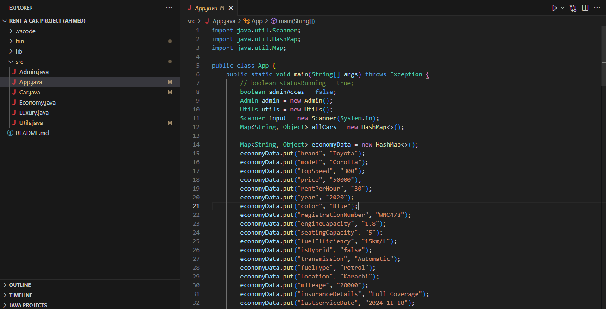
Import Scanner and Map to pass as an argument for Car class Constructor
Made admin access Boolean variable to check if admin has logged in
Admin, Scanner and utils objects made to be used in main

Slide 3
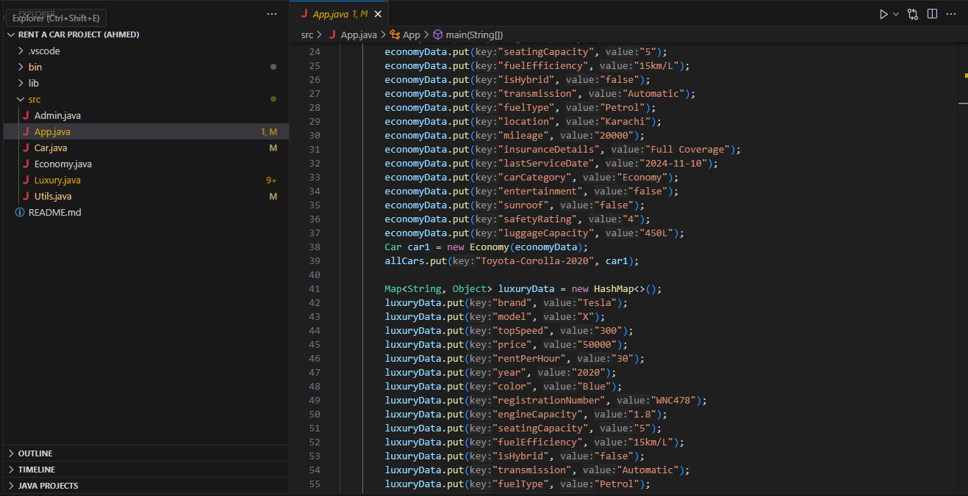
Made two map with car details to make an object of Car class to test the programs

Slide 4
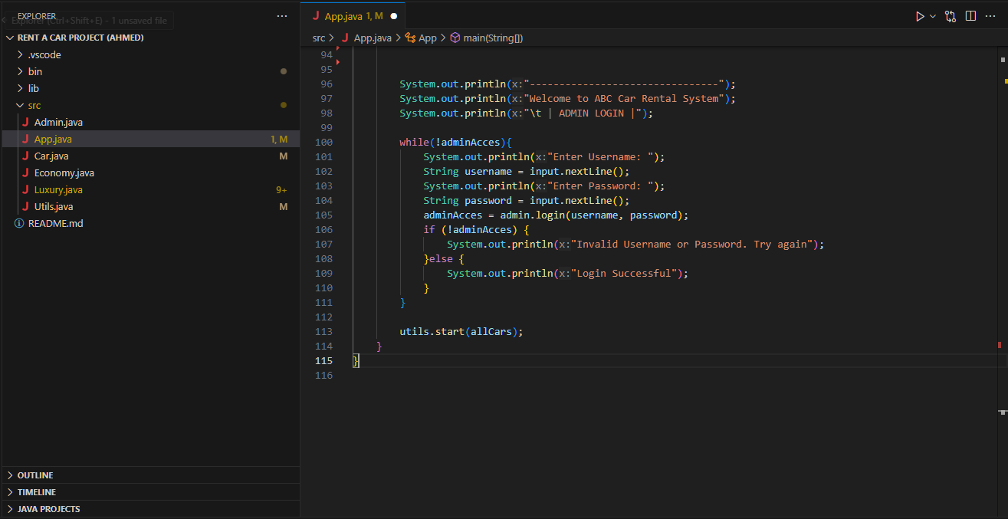

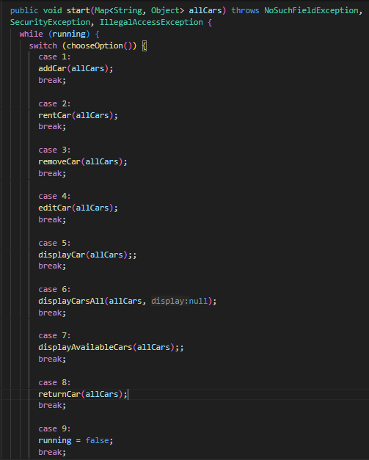
v
Calls login(username, password) method of admin object until right credentials are put and then sets admin access to true
Calls start method of utils object with all cars object as argument

Slide 5
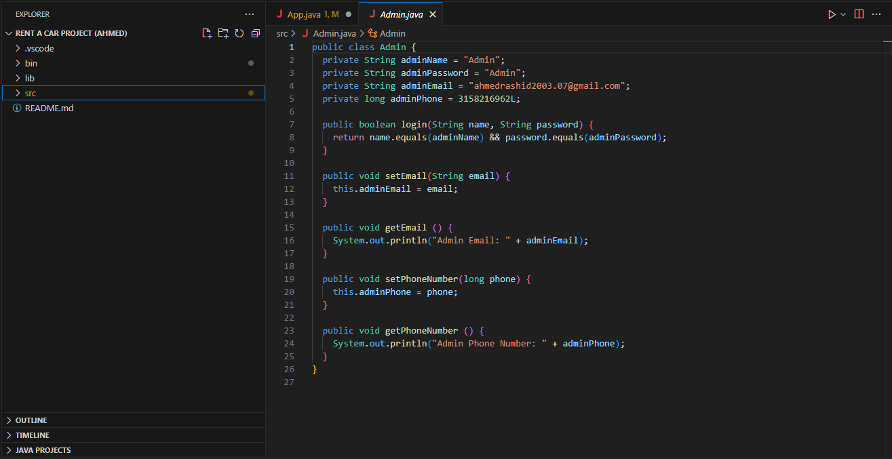
ADMIN CLASS

Slide 6
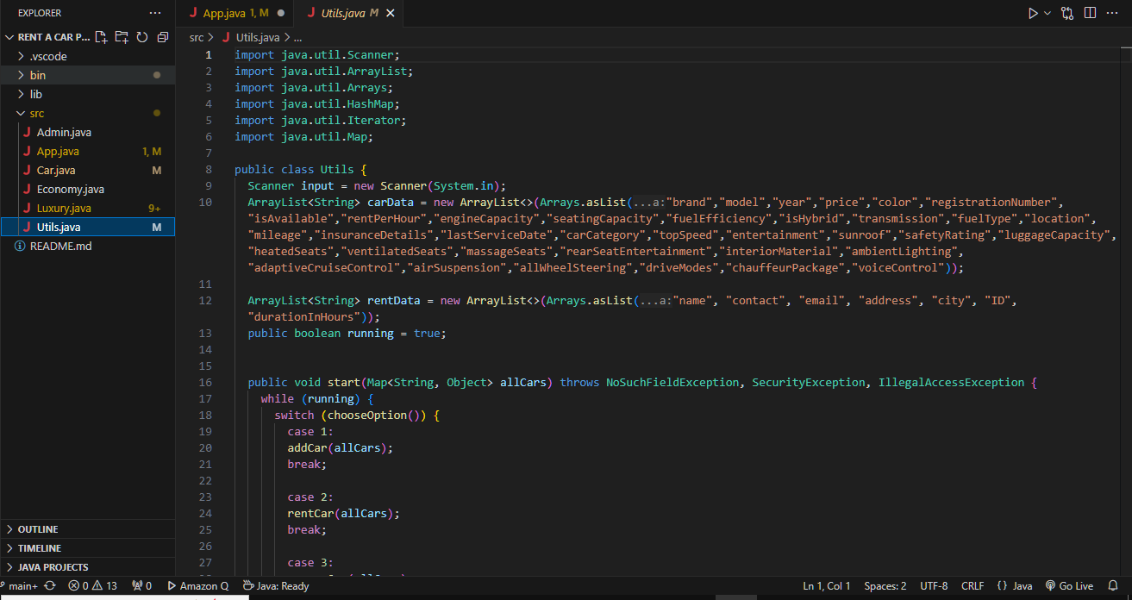
UTILS CLASS

Slide 7
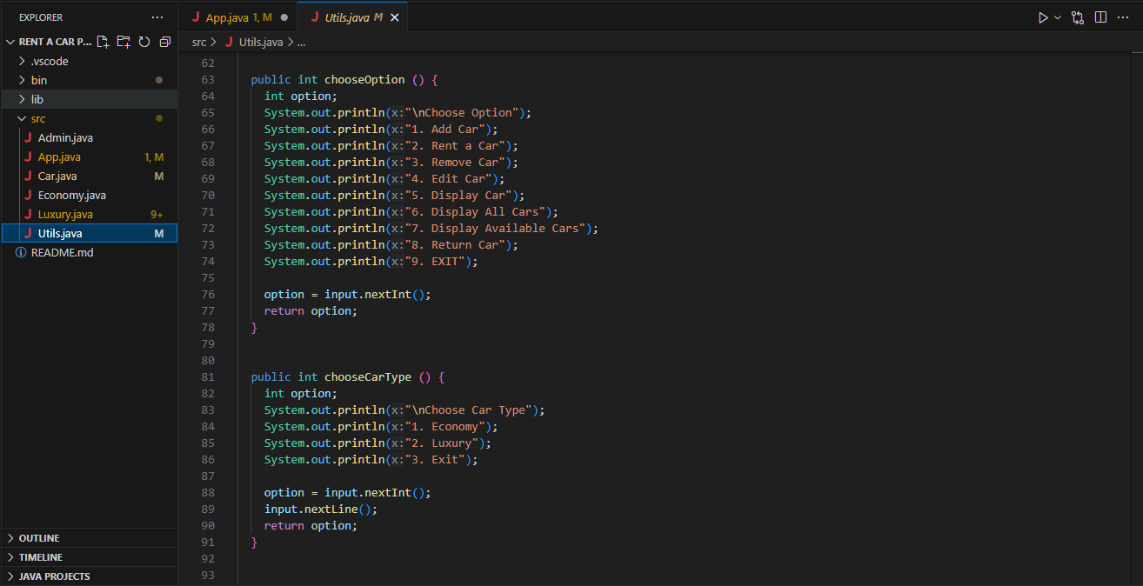

Slide 8
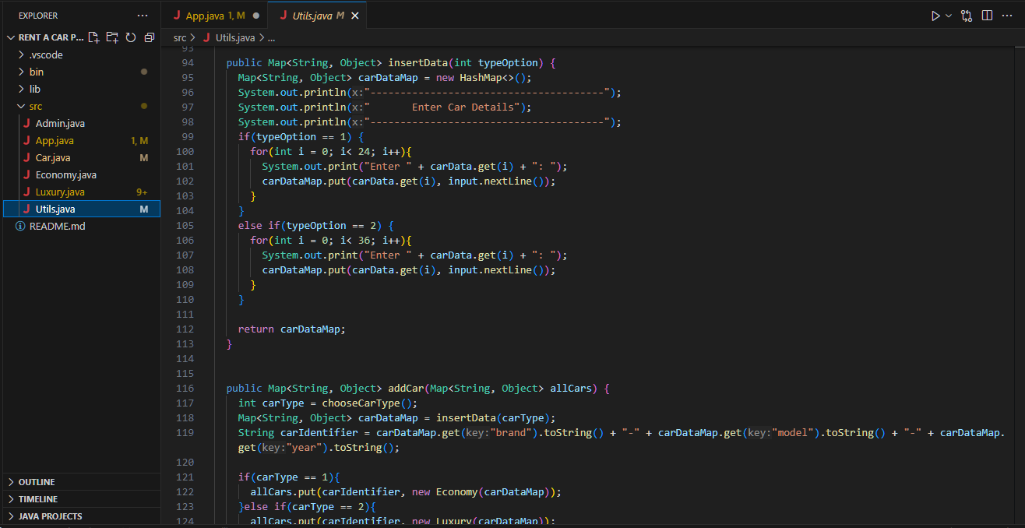

Slide 9
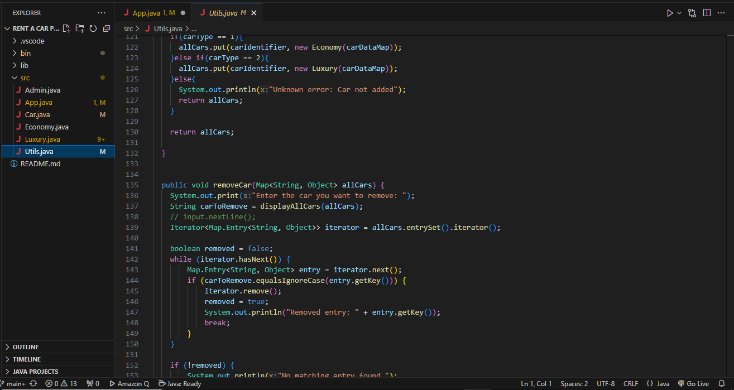

Slide 10
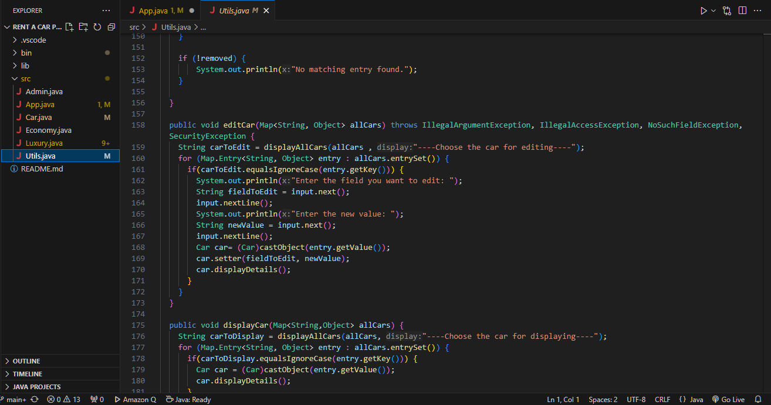

Slide 11
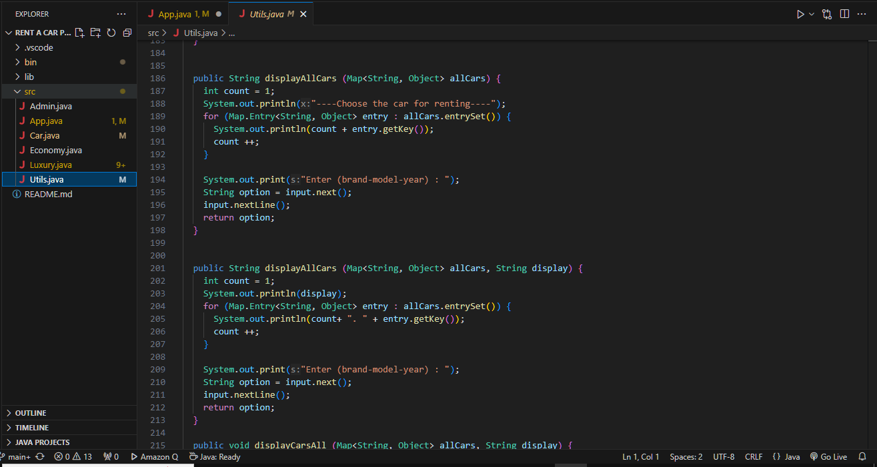

Slide 12
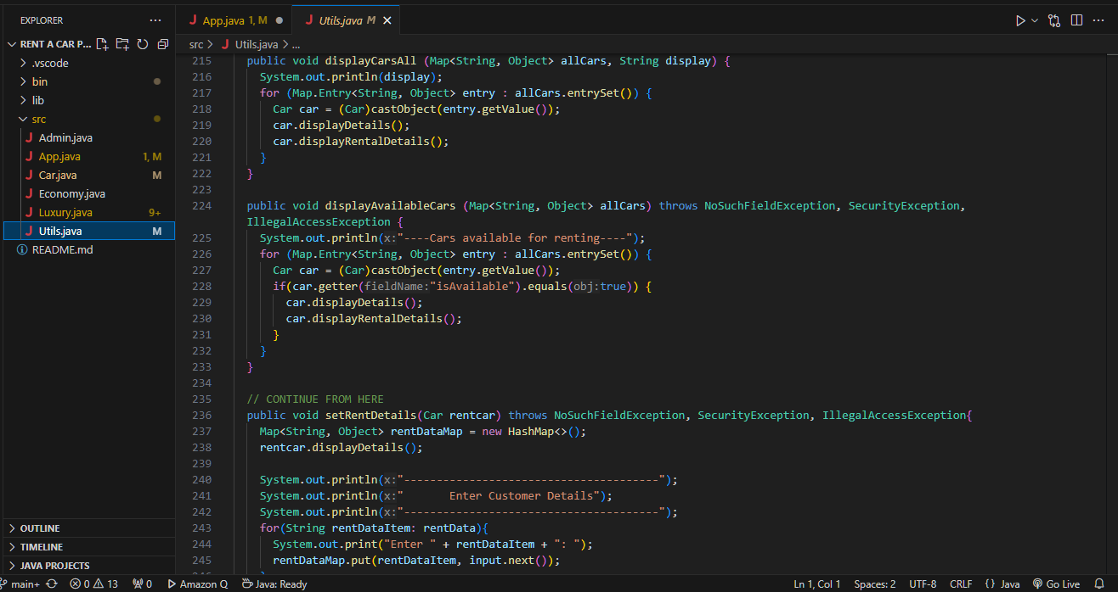

Slide 13
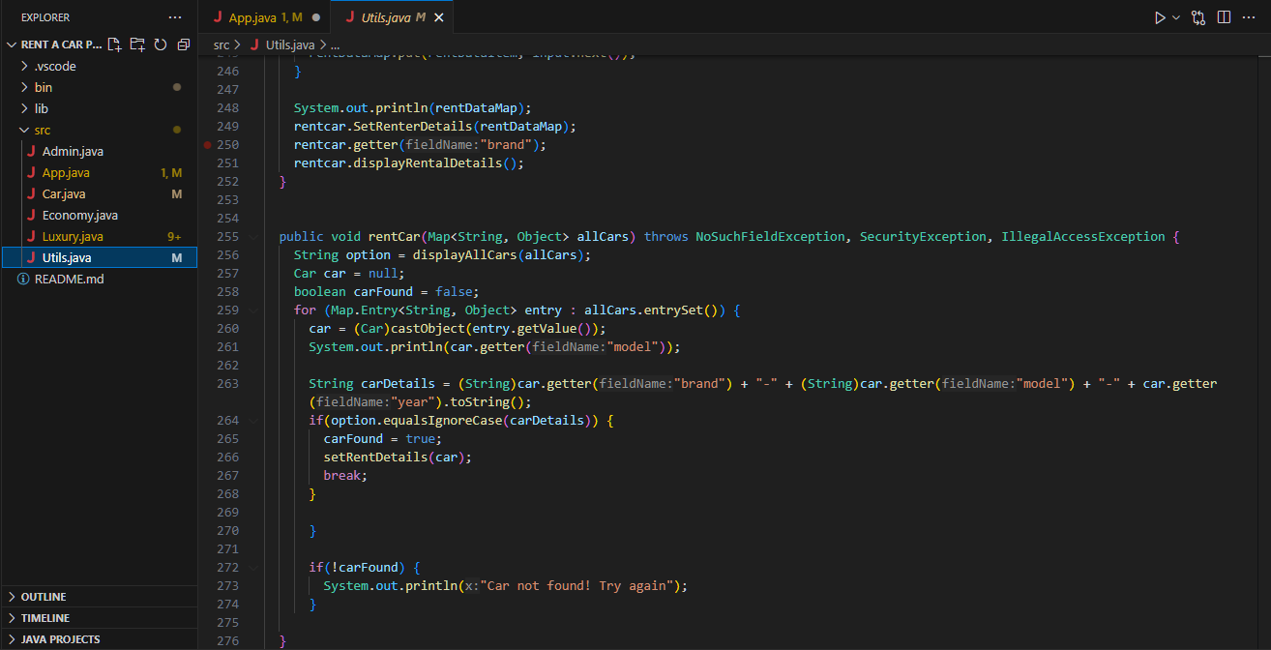

Slide 14
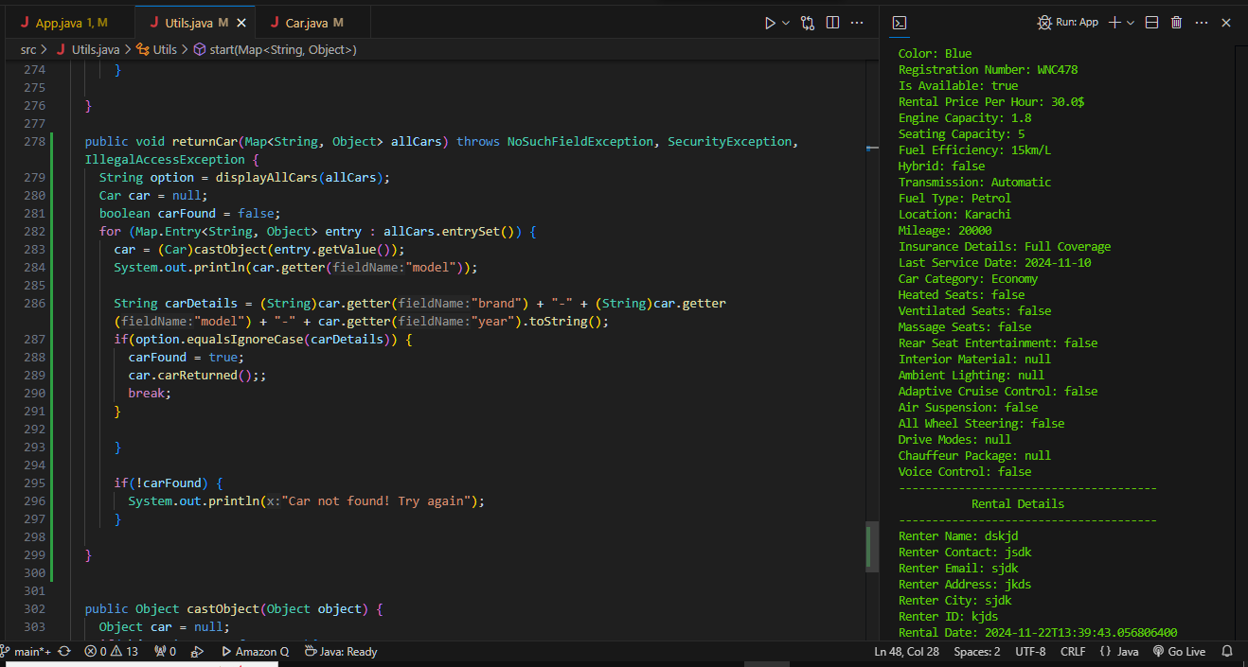

Slide 15
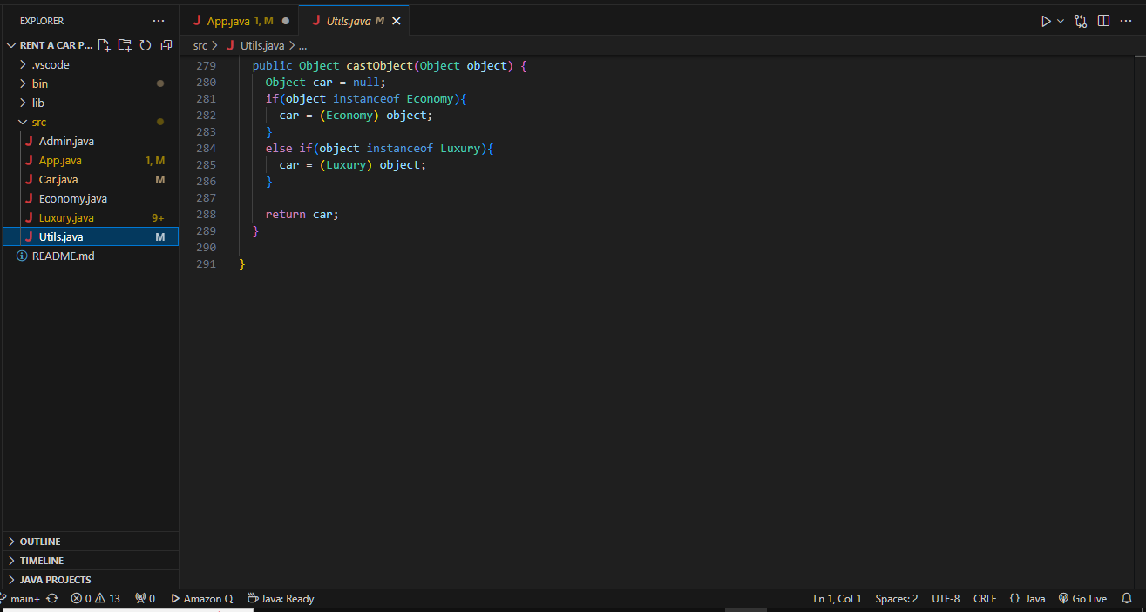

Slide 16

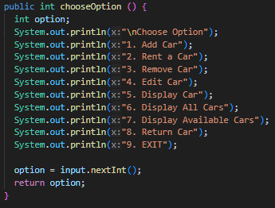
Chooseoption() method from utils is called which return a user input from 1 through 9 based on which a case is selected

Slide 17
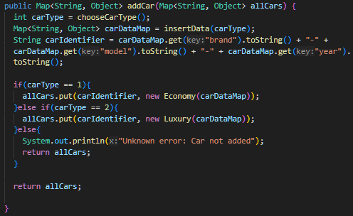
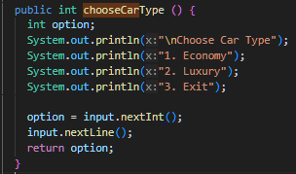
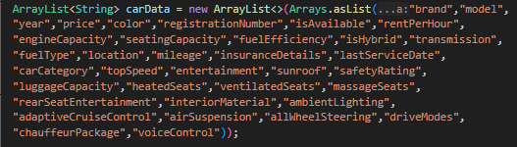
CASE 1
If user enter “1” then addCars(allCars) method is called from the utils class which in turns calls chooseCarType() from utils class to select which type of car to choose from user and then after selection it further proceed to loop an array to prompt user for car details which are stored in a Map to pass to Economy or Luxury cars class constructor to add a car to allCars Map
Ps: users are prompted according to car type to add they choose from an array in utils

Slide 18
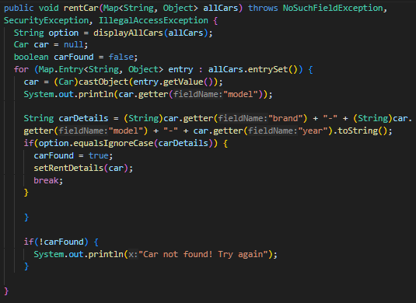
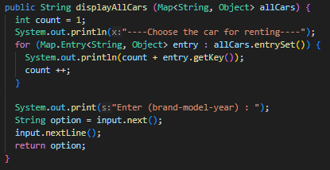
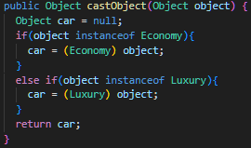
CASE 2 (METHOD OVERLOADING USED)
If user enter “2” then addCars(allCars) method is called from the utils class which also calls displayAllCars(Map<String, Object> allCars) with map parameter only (method overloading) (Two displayAllCars() with different parameters are present in utils class) CastObject( ) method is called which is used to cast the selected car object to rent from “allCars” map to the correct type to access the object method in Cars class such as setRentDetails()

Slide 19
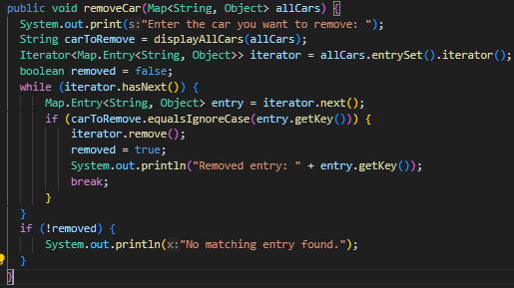
CASE 3
If user enter “3” then removeCar(allCars) method is called from the utils class which also calls displayAllCars(Map<String, Object> allCars) with map parameter only (method overloading) which takes input and returns it by which we can know which car to remove This method iterates through the allCars map to remove a car from the system

Slide 20
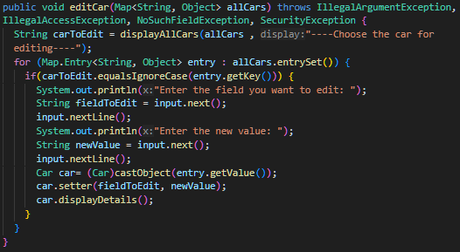
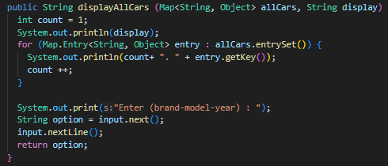
CASE 4
If user enter “4” then editCars(allCars) method is called from the utils class which also calls displayAllCars(Map<String, Object> allCars) with map and String parameter (method overriding) which takes input and returns it by which we can know which car to remove

Slide 21
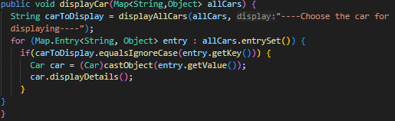
CASE 5
If user enter “5” then displayCar(allCars) is called which displays the car or users choice

Slide 22
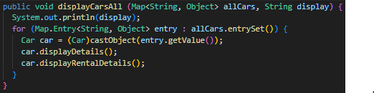
CASE 6

Slide 23
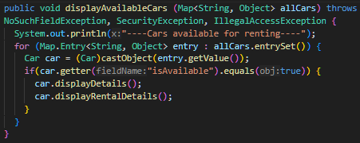
CASE 7
If user enter “7” then removeCar(allCars) method is called from the utils class which displays all the available cars for rent again castObject is used to use object methods from objects stored in allCars map

Slide 24
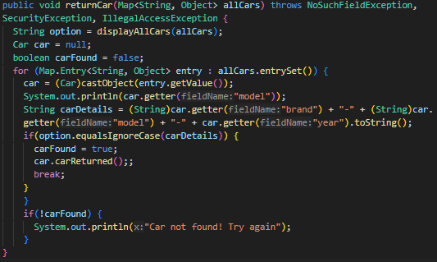

CASE 8 & 9
Case 8 returns are car from customer(sets its availability to true) while case 9 sets the running status to false hence stopping the program

Slide 25
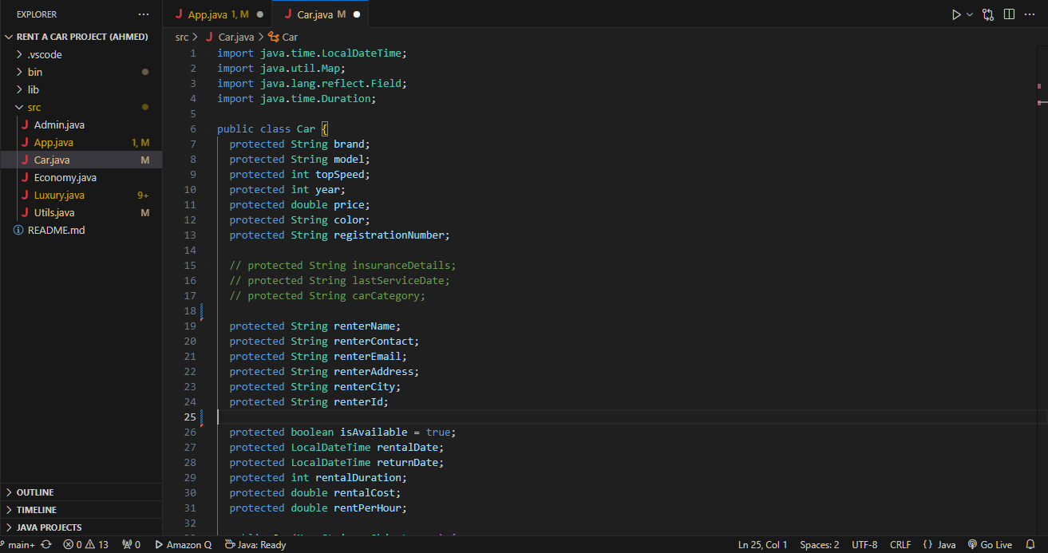
CAR CLASS (PARENT/BASE CLASS)
FIELDS UNIVERSAL TO EVERY CAR

Slide 26
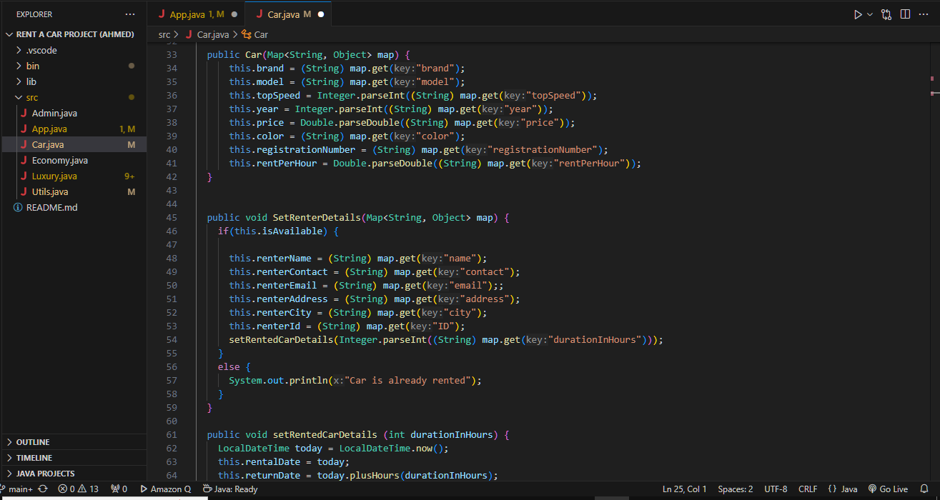
CONSTRUCTOR CAR IS USED

Slide 27
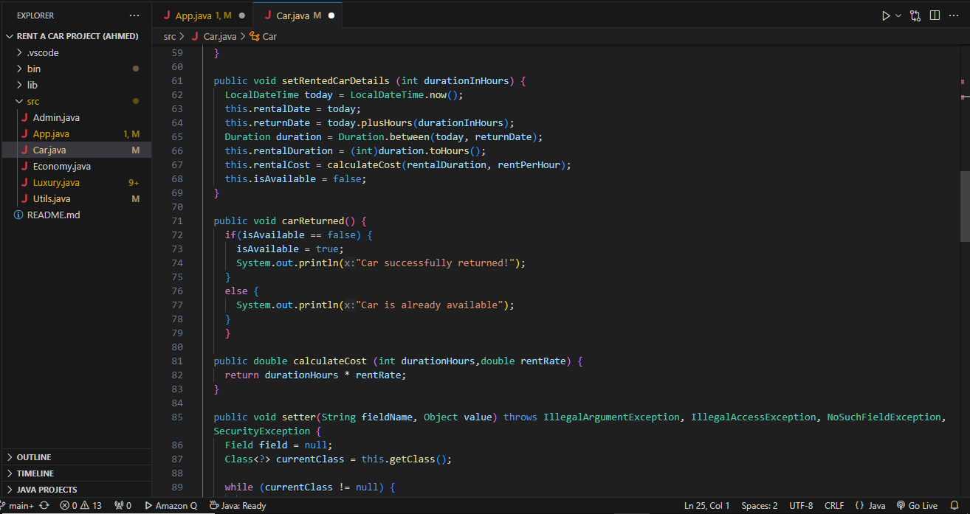
UNIVERSAL SETTER FUNCTION (SETS ANY FIELD)
ENCAPSULATION USING SETTER FUNTION WHILE THE FIELDS ARE PROTECTED THROWS EXCEPTIONS BECAUSE GET DECLARED FIELD METHOD THROWSS EXCPTIONS

Slide 28
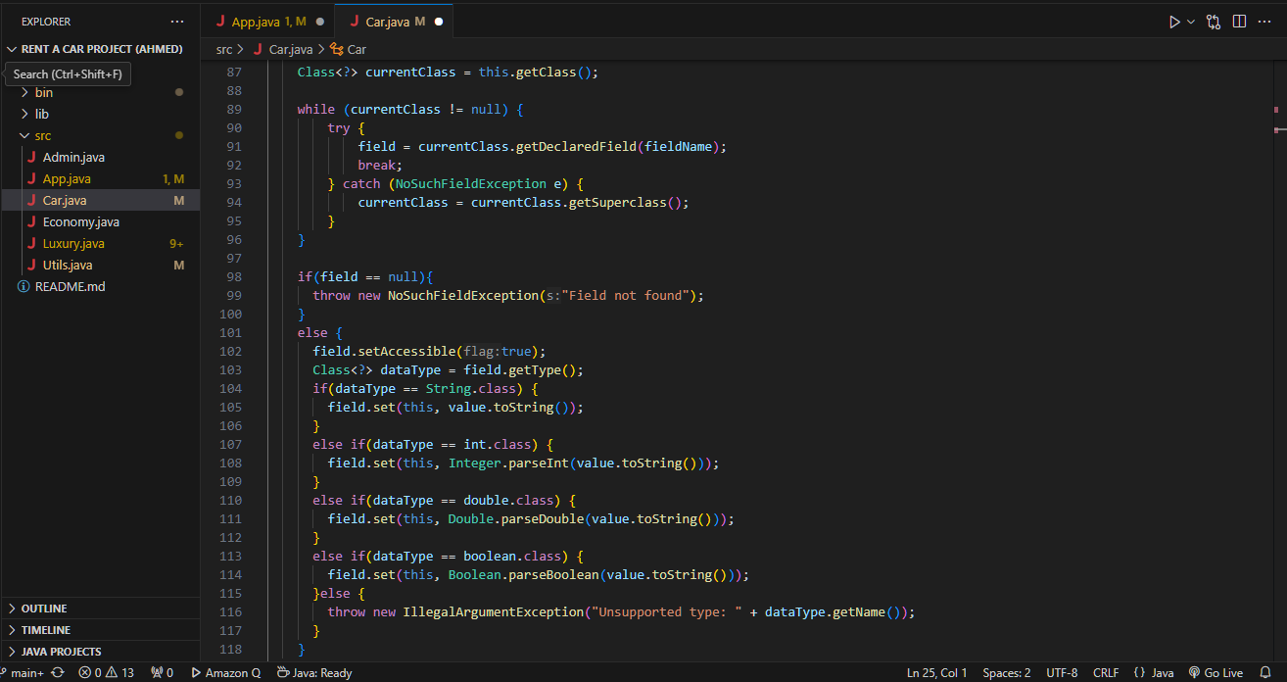

Slide 29
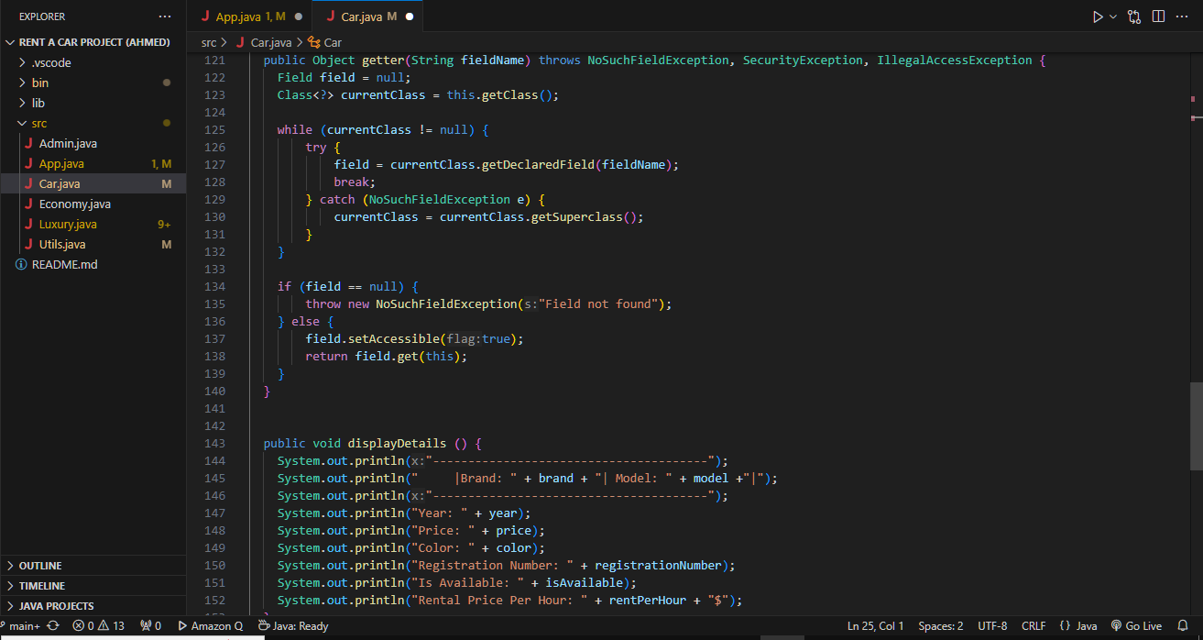
UNIVERSAL GETTER FUNTION THROWS EXCEPTIONS BECAUSE GET DECLARED FIELD METHOD THROWSS EXCPTIONS

Slide 30
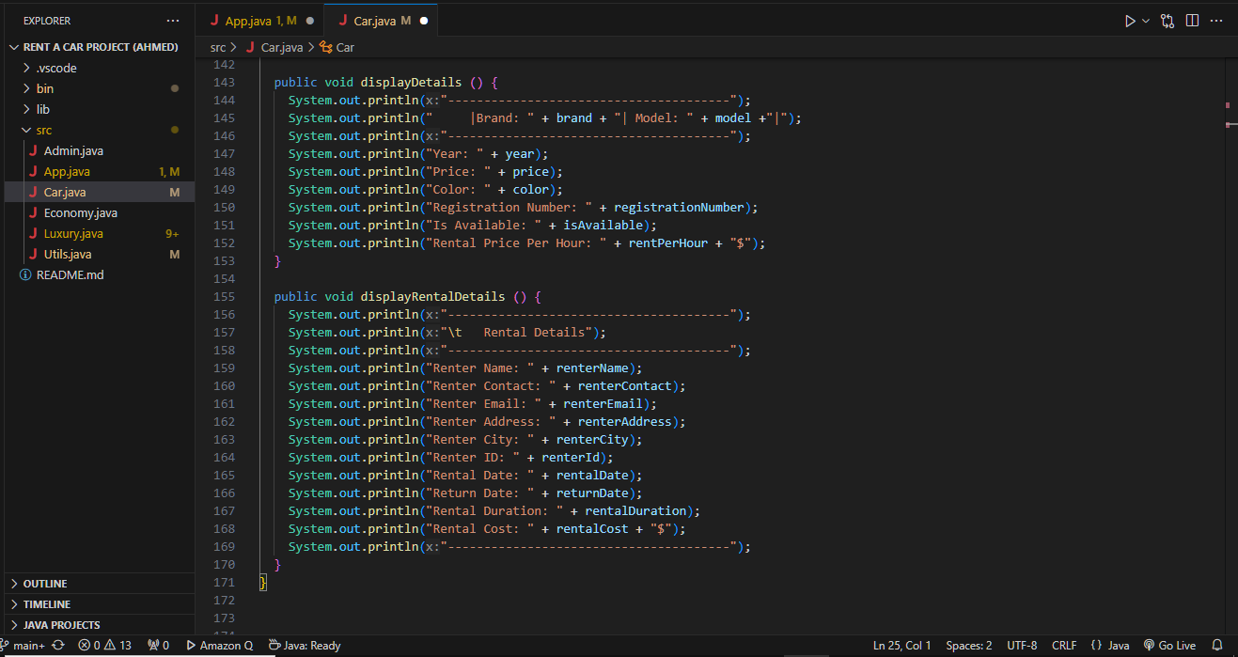
METHOD TO DISPLAY DETAILS ABOUT A CAR

Slide 31
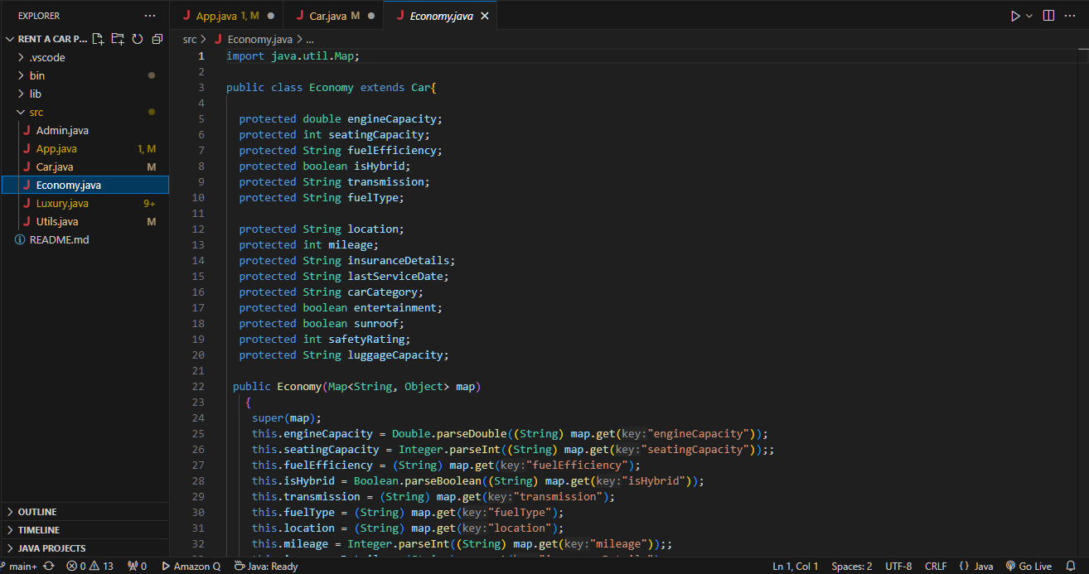
ECONOMY CLASS
POLYMORPHISM: INHERITS FROM CAR CLASS
FIELDS SPECIFIC TO ECONOMICAL CAR (INHERITS UNIVERSAL FIELDS FROM PARENT CLASS CAR)

Slide 32
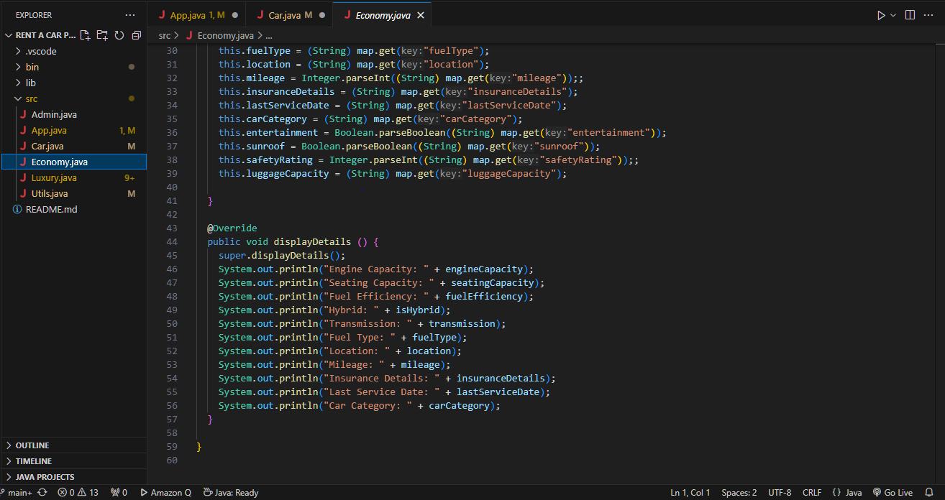
(METHOD OVERRIDING)OVER RIDES METHOD FROM PARENT CLASS

Slide 33
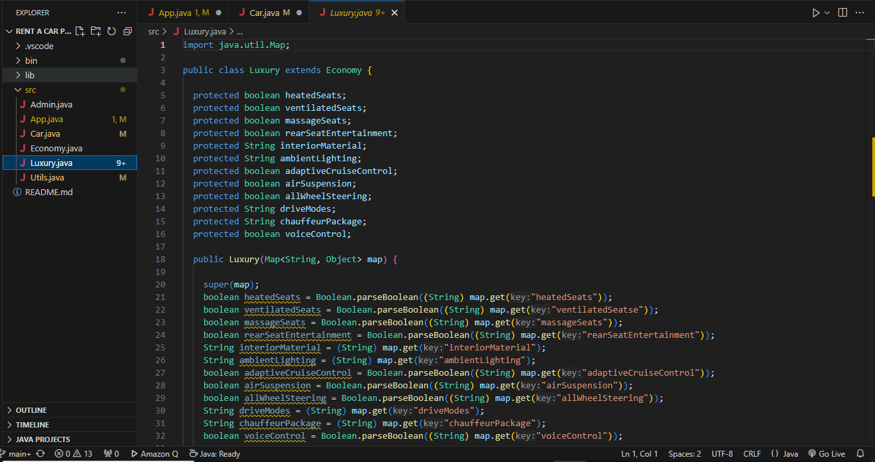
LUXURY CARS CLASS
POLYMORPHISM: INHERITS FROM ECONOMY (MULTILEVEL INHERITENCE)
FIELDS SPECIFIC TO LUXURY CAR (INHERITS FIELDS FROM PARENT CLASS ECONOMY AND CAR)

Slide 34
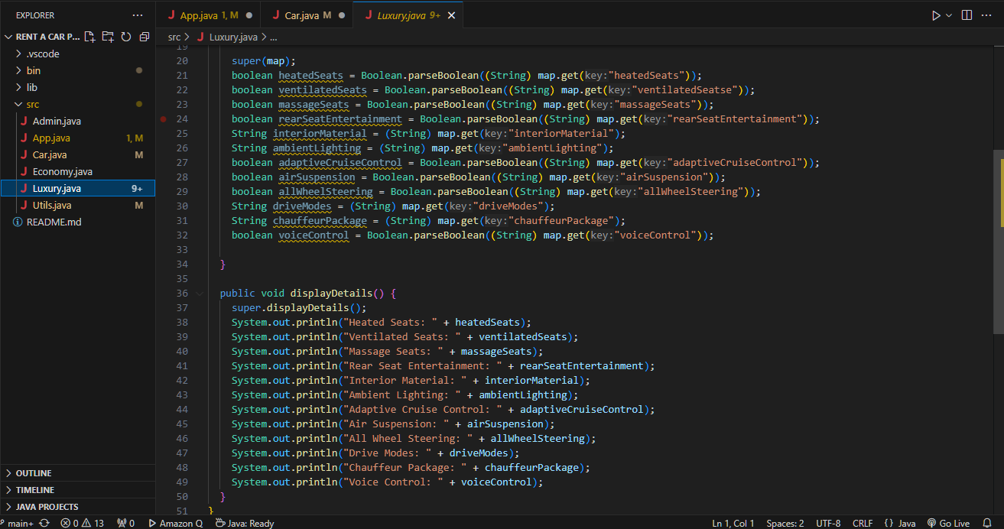
(METHOD OVERRIDING) OVERRIDES METHOD FROM PARENT CLASS

